Slide 1
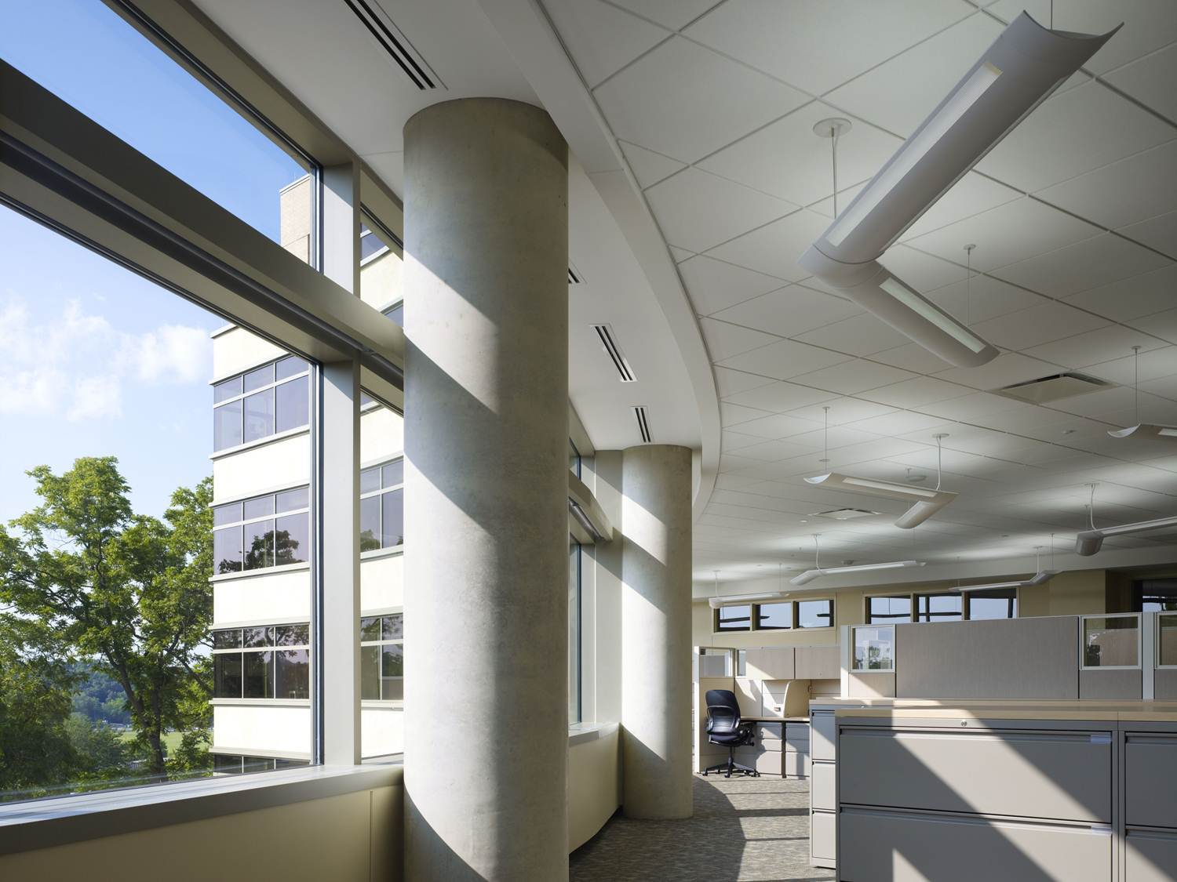
Lighting
Daylighting
Indoor lighting
Outdoor lighting

Slide 2
Illumination
Typical sunlight →
Bright office →
Moonlight →
Lux = 1 lumen / m²
Lumen = A quantity of light provided by a source
1 lm = 1 cd·sr (wikipedia)
Lm = lumen, cd = candela, sr = steridian
Candela = power of light emitted in one direction
A candle emits ~ 1 candela
www.brillianz.co.uk
Notes:
Typical sunlight → 32,000 to 100,000 lux
Bright office → ~ 400 lux
Moonlight → ~ 1 lux
Lumen unit of measurement of the amount of brightness that comes from a light source. Lumens define "luminous flux," which is energy within the range of frequencies we perceive as light. For example, a wax candle generates 13 lumens; a 100 watt bulb generates 1,200 lumens. (www.pcmag.com)
The lumen (symbol: lm) is the SI derived unit of luminous flux, a measure of the total "amount" of visible light emitted by a source. Luminous flux differs from power (radiant flux) in that luminous flux measurements reflect the varying sensitivity of the human eye to different wavelengths of light, while radiant flux measurements indicate the total power of all light emitted, independent of the eye's ability to perceive it. A lux is one lumen per square meter.
The lumen is defined in relation to the candela as
1 lm = 1 cd·sr A full sphere has a solid angle of 4·π steradians,^{[1]} so a light source that uniformly radiates one candela in all directions has a total luminous flux of 1 cd·4π sr = 4π ≈ 12.57 lumens.^{[2] (Wikipedia)}
The candela (pron.: /kænˈdɛlə/ or /kænˈdiːlə/; symbol: cd) is the SI base unit of luminous intensity; that is, power emitted by a light source in a particular direction, weighted by the luminosity function (a standardized model of the sensitivity of the human eye to different wavelengths, also known as the luminous efficiency function^{[4][5]}). A common candle emits light with a luminous intensity of roughly one candela.(Wikepedia)

Slide 3
Recommended light levels
Activity | Illumination (lux)
Office
Conference Rooms
Dining Area
Internal Corridors
Auditorium
Kitchen
Open Parking Spaces
Outdoor Walkways
www.gsa.gov
Notes:
Activity / Illumination (lux)
Office 500
Conference Rooms 300
Dining Area 150-200
Internal Corridors 200
Auditorium 150-200
Kitchen 500
Open Parking Spaces 30
Outdoor Walkways 6

Slide 4
Daylighting
Designing or retrofitting buildings to use daylight as lighting source
Passive
Active
Notes:
Designing or retrofitting buildings to use daylight as lighting source
Passive
Skylights & Windows
Glazing, Shades & Blinds
Light Shelves
Translucent Walls
Light Tubes
Active
Devices that mechanically track sun & redirect sunlight inside building
Sensors used to control shades, glazing, or electric lights

Slide 5
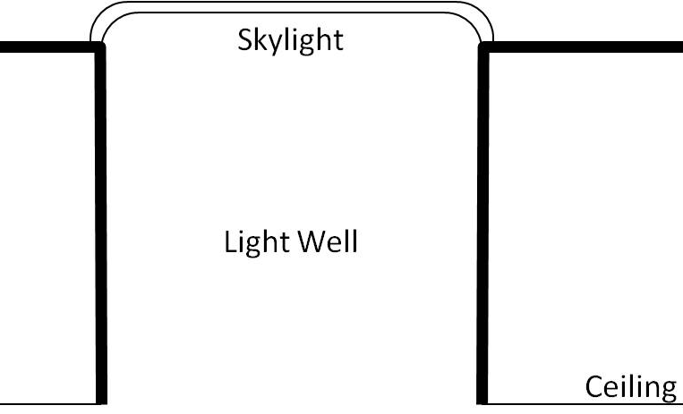
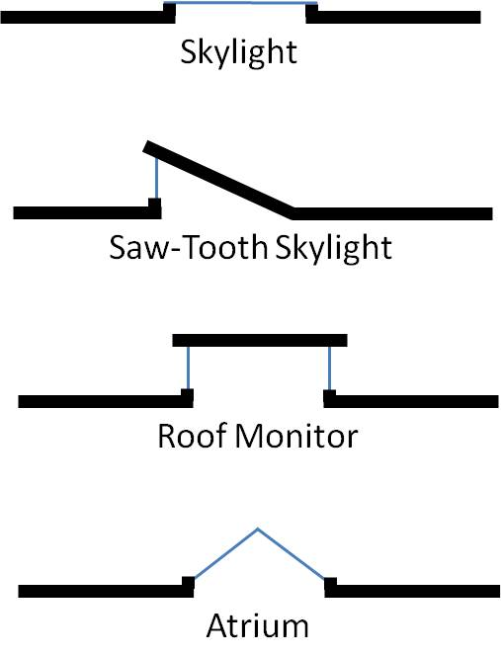
Top Lit

Slide 6
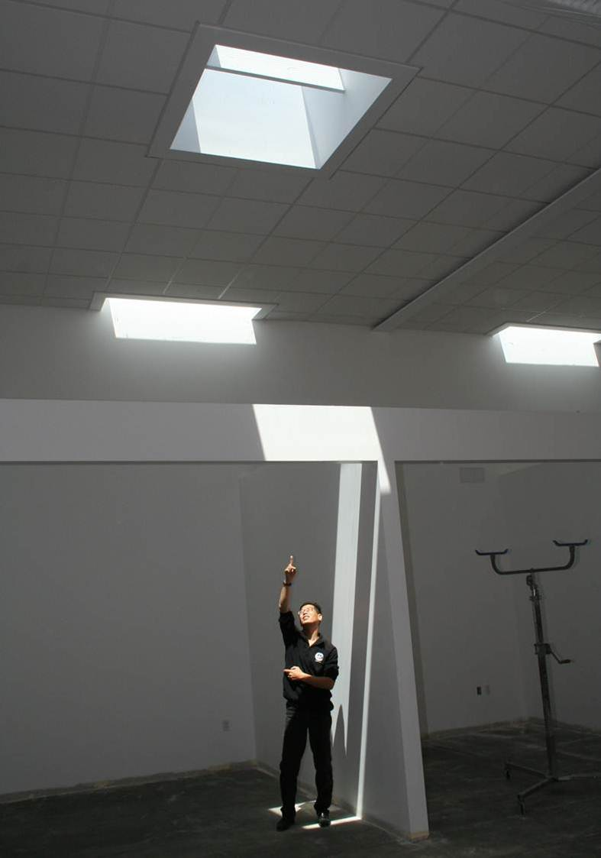
Skylight
In this application: Diffusing panels used in summertime
ideasnetzero.wordpress.com
Notes:
The panels were installed in the late spring to manage direct-beam sunlight entering through the skylights during summer months. IDeAs has experimented with various types of sunlight control concepts, and the diffusing panels appear to be an effective and practical solution. The panels diffuse the intense, focused beams of light characteristic of summer sunlight to a softer, more diffuse light.
Experimenting with diffusing panels is just one more aspect of IDeAs’ ongoing post-occupancy research efforts to maximize the performance and comfort of the building. The slight reduction in daylighting from adding the panels is acceptable in the summer months when the building interior is actually overlit, with the added benefit of reducing the cooling load with minimal increase in electric lighting energy.
The skylights are so key to IDeAs’ achievement of its net zero energy goal, it is worth noting all the thought that has gone into them.

Slide 7
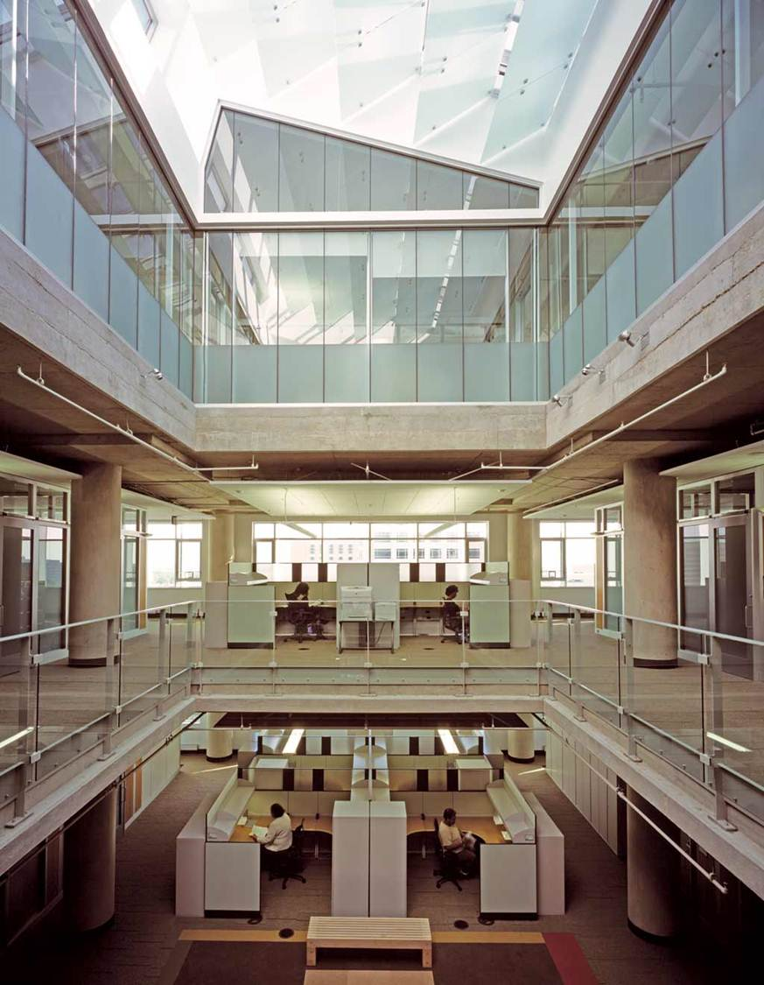
Atrium
www.designshare.com

Slide 8
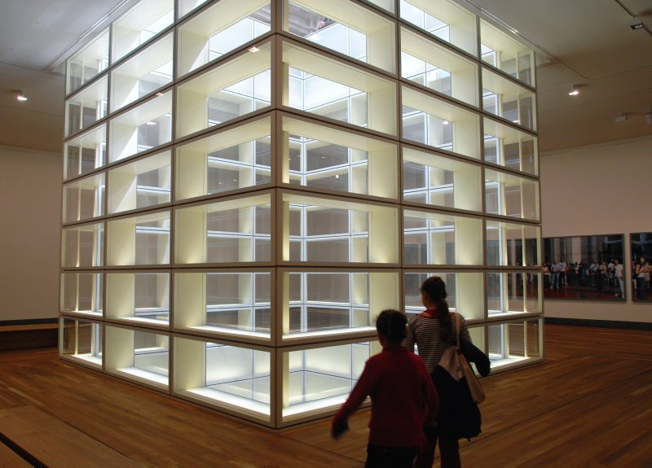
Light Well
www.ics.ele.tue.nl

Slide 9
Side Lit
Windows
Window in Light Well
The higher the window, the farther light penetrates the interior space
Ernest Orlando Lawrence Berkeley National Laboratory (1997) “Tips for Daylighting”, LBNL-39945
Notes:
The higher the window, the farther light penetrates the interior space
~1.5 times window head height

Slide 10
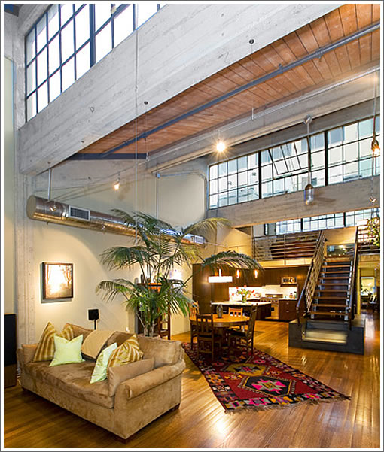
Windows
www.socketsite.com

Slide 11
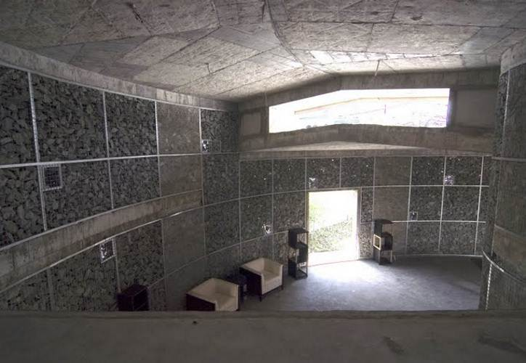
Windows
assets.inhabitat.com

Slide 12
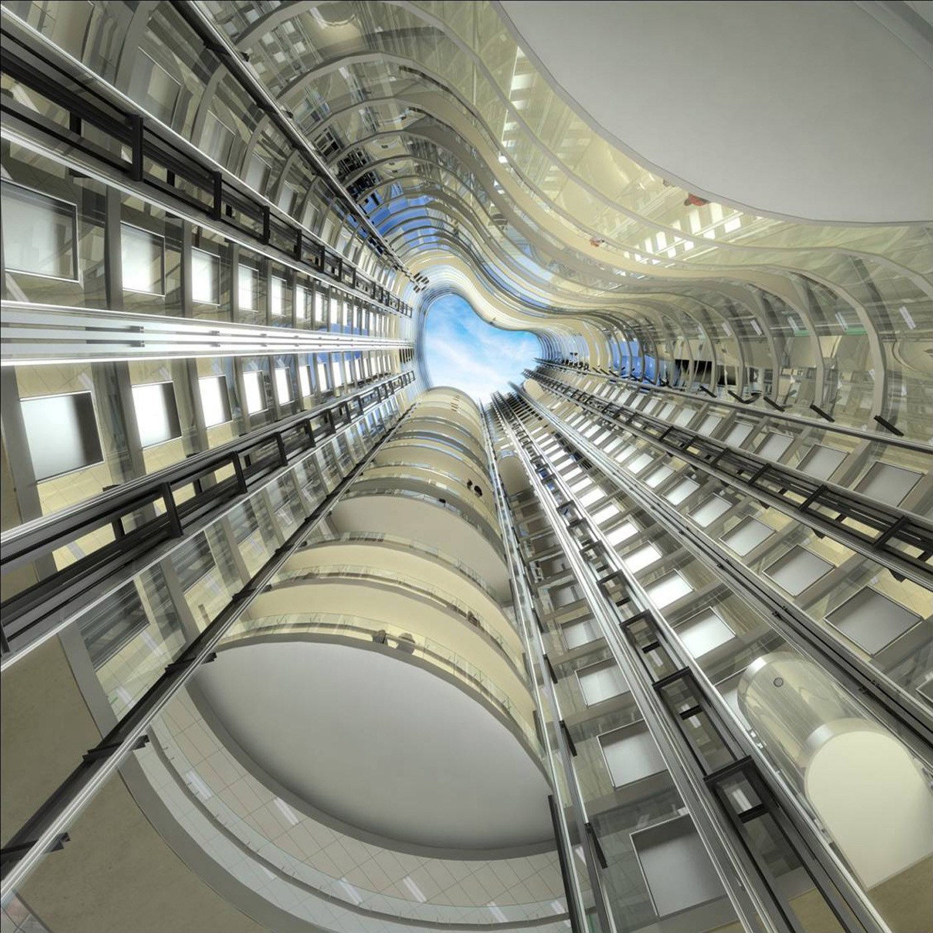
Interior Atrium
Bligh Building
Sydney, Australia
www.djc.com

Slide 13
Side Lit Orientation
North
High quality consistent daylight
Minimal heat gains in summer
Thermal loss in winter
South
Good access to strong illumination
Illumination varies through the day
East and West
Fixed external shading is difficult
Ernest Orlando Lawrence Berkeley National Laboratory (1997) “Tips for Daylighting”, LBNL-39945
Notes:
North
High quality consistent daylight
Minimal heat gains in summer
Thermal loss in winter
Shading may be needed early morning and/or late afternoon
South
Good access to strong illumination
Illumination varies through the day
Fixed external shading can be effective
East and West
Fixed external shading is difficult
Internal shading important for comfort & solar gain

Slide 14
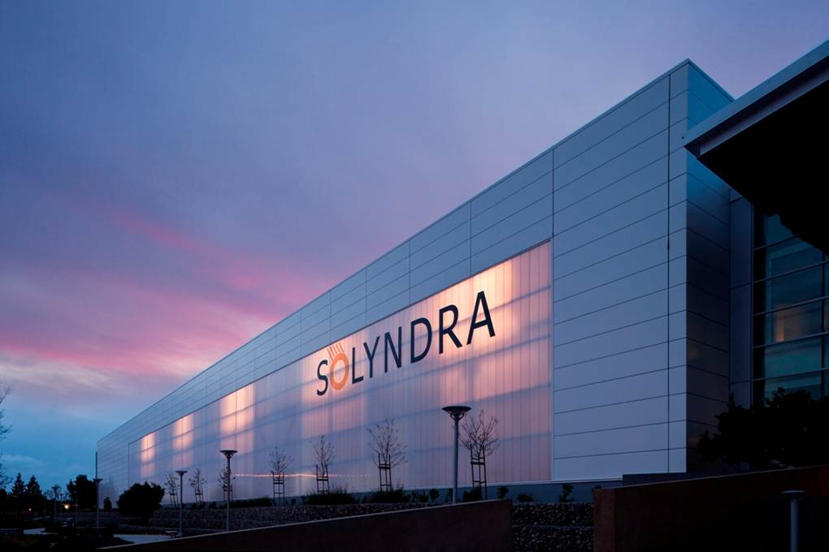
Translucent Wall
www.duo-gard.com

Slide 15
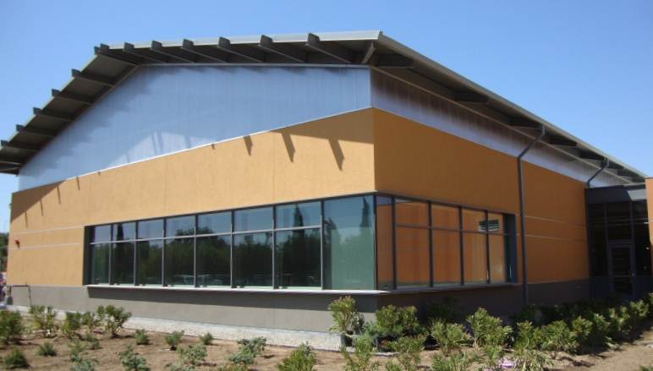
Clerestory
www.duo-gard.com
Notes:
In architecture, clerestory are any high windows above eye level. The purpose is to bring outside light, fresh air, or both into the inner space. (wikipedia)

Slide 16
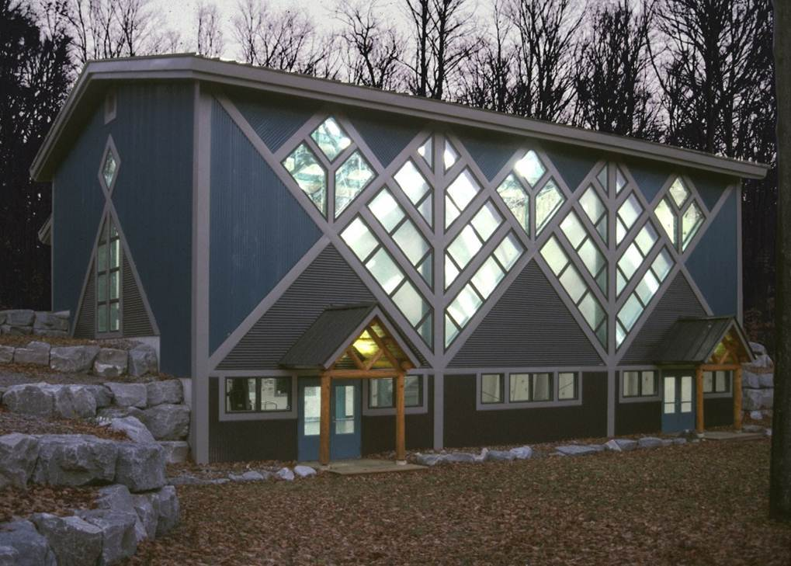
Curtain wall
www.duo-gard.com
Notes:
Combine high diffuse light and high thermal values with unique aesthetics in vertical applications.
A curtain wall is a nonbearing exterior wall between columns or piers. (meriam-webster)

Slide 17
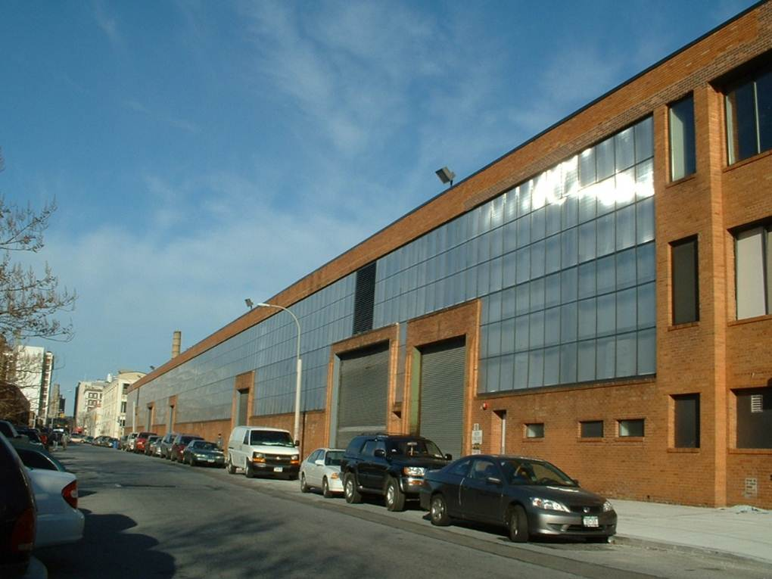
Overglazing
Renovation without demolition
Improve energy efficiency
Maintain natural daylight with diffusion technology
www.duo-gard.com

Slide 18
Window Rules of Thumb
Strip windows provide more uniform light
Separate daylighting &viewing windows
Us light-colored surfaces to reflect light
Don’t waste glazing, e.g., below desk height
Ernest Orlando Lawrence Berkeley National Laboratory (1997) “Tips for Daylighting”, LBNL-39945
Notes:
wiki.naturalfrequency.com | ECOTECT COMMUNITY WIKI!
Archive site for Autodesk Ecotect Analysis educational resources, notes and tutorials
Daylighting: Design Strategies
Strip windows provide more uniform light
Avoid/minimize breaks between windows
Separate daylighting &viewing windows
Put daylighting windows up high
Incorporate separate shading elements
Us light-colored surfaces to reflect light
Ceilings, shelves, beams,…
Locate windows near light-colored elements
Don’t waste glazing, e.g., below desk height

Slide 19
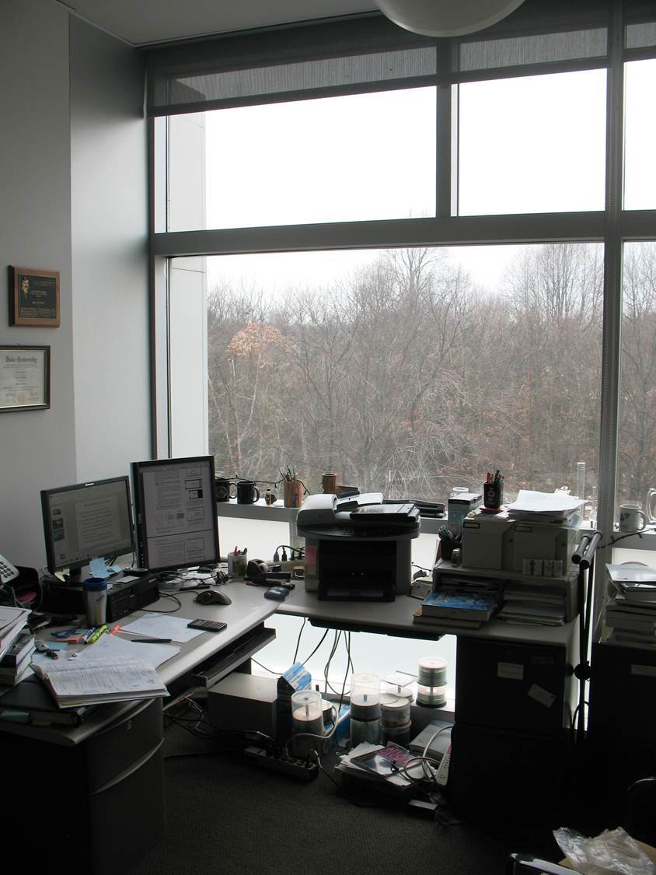
What’s wrong with my office?
Notes:
Only one shade
Glazing wasted
To close to window
No external shading (SW)

Slide 20
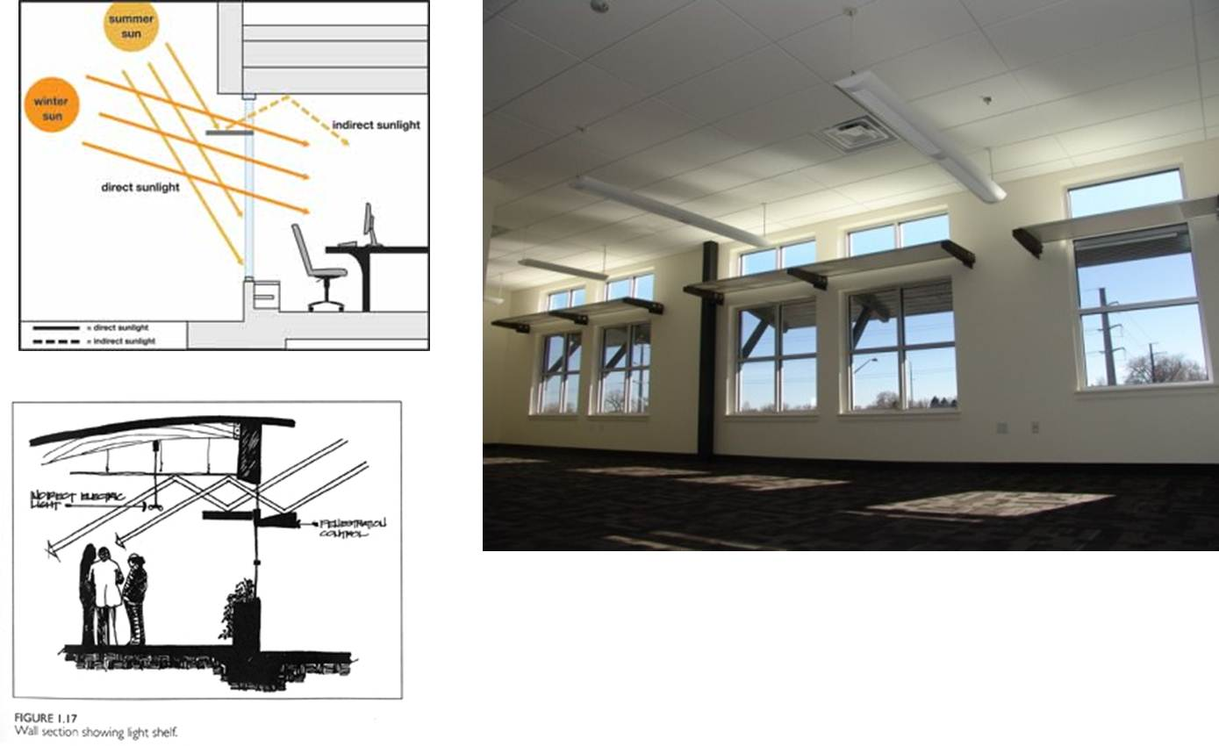
Light Shelves
archrecord.construction.com
assets.inhabitat.com
With ceiling reflection, useful light penetrates farther into room
www.ies.org
Notes:
Daylight is a major theme as it is aggressively controlled on the south side to reduce glare and heat buildup. The exterior overhangs come in two design flavors but both are made from simple off-the-shelf material to keep down cost. The interior light shelves, which bounce daylight deep into the space, are also made from low cost materials. Light sensors and an efficient HVAC system reduce energy loads although Olexa would have preferred more occupant involvement like light switches, and the windows do not open. A finished concrete floor on the main level also reduced materials and cost. Low VOC finishes and materials like Interface Floor tiles and green ceiling tiles contribute to the healthy work environment.
While cost savings was a major point of the project, building performance was carefully considered. The steel framing of the exterior walls are insulated with spray foam and then wrapped and taped in 2 inches of Thermax foam board for added insulation and to sharply reduce thermal bridging. Envelope commissioning validated a very low air infiltration rate for a commercial building.
Read more: New LEED Platnium RMi2 Building Incubates Cutting Edge Green Companies | Inhabitat - Sustainable Design Innovation, Eco Architecture, Green Building

Slide 21
Problems Solutions
Too Small
Obstructed
Too Big
Glare
Heat Gain, Heat Loss
Fading
Clouds
Lighting interior
Only penetrates so far
Blocked by walls & partitions
Save 35-60% on Lighting, plus save on HVAC
Notes:
The New Buildings Institute states daylight harvesting systems can generate maximum potential savings of 35-60%. The Lighting Design Lab states lighting energy savings can reach 60-80% in offices, classrooms and gymnasiums. According to the U.S. Department of Energy, daylight-response switching coupled with skylights has demonstrated energy savings in warehouses of 30-70%. (www.lightnowblog.com)
Solutions:
Orientation
e.g., North Facing Saw-Toothed Skylight
External Shading
Overhang, Awning
Internal Shading
Shades, Blinds
Glazing, Tinting, Reflection
Passive, Active
Double & Triple Panes
Reflection (Not on window)
Light Shelves, Light Wells
Sensors
Light Wells

Slide 22
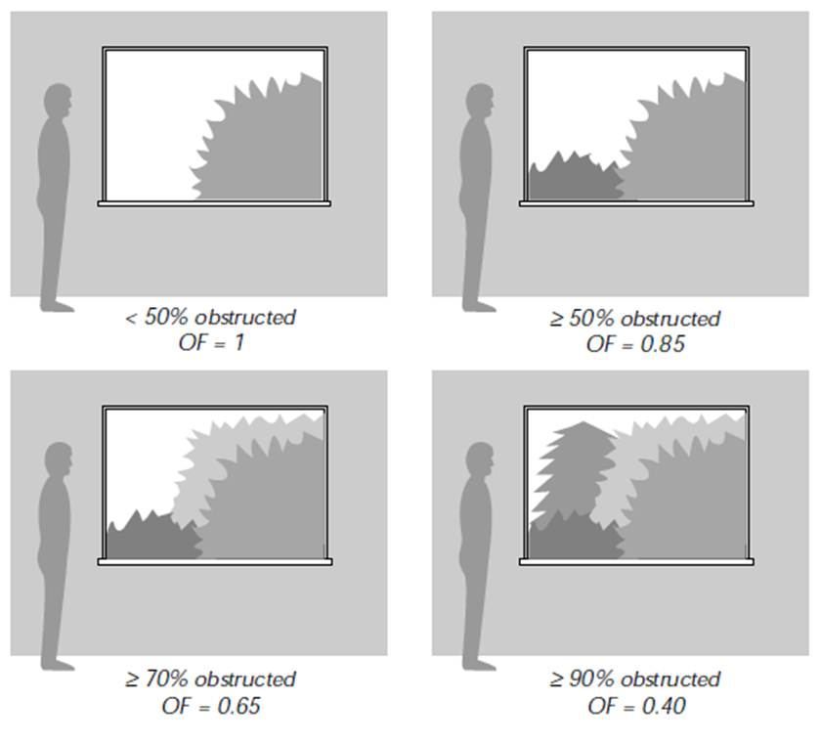
Feasibility of Daylighting
FF = WW_{R} V_{T} OF
FF = Feasibility Factor (if ≥0.25 daylighting is feasible)
WW_{R} = Window-to-Wall ratio
V_{T} = Visible Transmittance
OF = Obstruction Factor
Ernest Orlando Lawrence Berkeley National Laboratory (1997) “Tips for Daylighting”, LBNL-39945

Slide 23
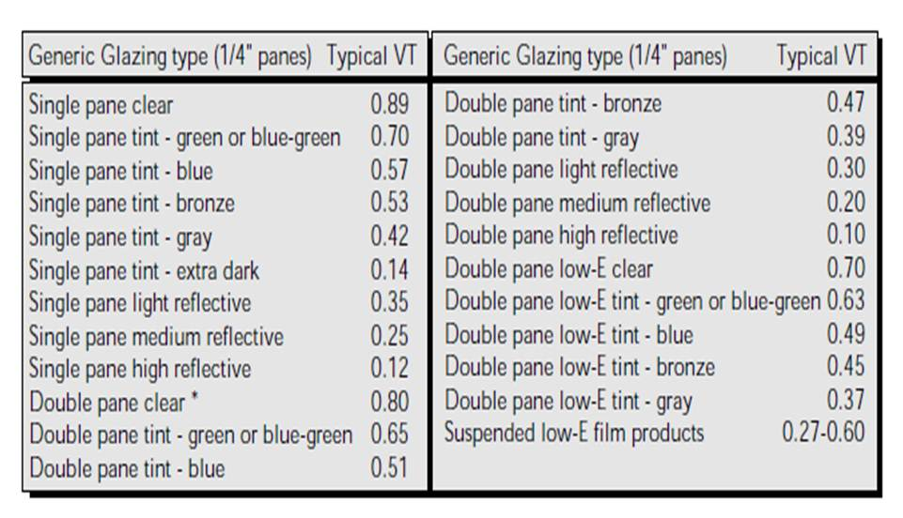
Visible Transmittance, V_{T}
*Double pane numbers also apply to laminates
Ernest Orlando Lawrence Berkeley National Laboratory (1997) “Tips for Daylighting”, LBNL-39945

Slide 24
Feasibility Example
Is daylighting feasible at the desk in the room described below?
Given
Eight windows are each
635 mm (Width) by 1505 mm (Height)
Double Pane clear
The wall area is 6 m long by 2.5 m high
Viewed from the desk, the daylighting scenario is most like the upper right, ≥ 50 % obstructed

Slide 25
Feasibility Example Cont.
WW_{R} =
V_{T} =
From table given previously
OF =
From Figure given previously
FF =
Ernest Orlando Lawrence Berkeley National Laboratory (1997) “Tips for Daylighting”, LBNL-39945
Notes:
WW_{R} = (8⋅0.635 m⋅1.505 m) / (5 m⋅2.5 m) = 0.61
V_{T} = 0.8
From table given previously
OF = 0.85
From Figure given previously
FF = 0.61 ⋅ 0.8 ⋅ 0.85 = 0.41
0.41 ≥ 0.25, desk can be illuminated by day light

Slide 26
External Shading
Configure fixed shading to
allow winter sunlight in directly
Shade summer sunlight
South Orientation

Slide 27
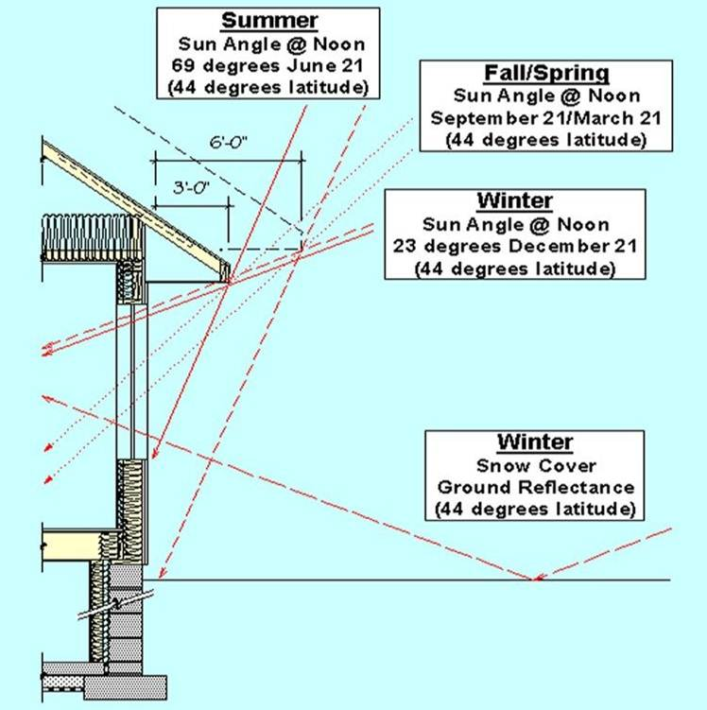
Stanton W. Mead Center - Milladore, WI
www.tombrownarchitect.com

Slide 28
Overhang Design
O = Overhang Length, m
T = Distance to Top of Window
B = Distance to Bottom of Window
α_{w} = Sun altitude at Noon June 21
α_{s} = Sun altitude at Noon Dec. 21
tan α_{w} = T/O
tan α_{s} = B/O
O
T
α_{W}
B
α_{S}
Notes:
www.susdesign.com/overhang/-> An important note about overhangs in temperate climates
If you're using this tool to optimize an overhang to provide shade at certain times of year and admit sun at others, please keep in mind that in most temperate climates, the hottest time of year is one to two months after the summer solstice, and the coldest time of year is one to two months after the winter solstice. This is due to the significant thermal inertia of the surface of the Earth.
This phenomenon means that it's not enough to provide shade on the summer solstice and admit sun on the winter solstice; it's important to review local climate data in order to determine which months are the most critical for heating and cooling, and optimize an overhang to provide and avoid shade at those times.
This isn't easy, of course, since the inertial lag means that the sun will follow the same path in the sky a couple months before and after each solstice, and you'll probably want shade at one of those times but sun at the other. Your climate and building design may warrant a bias toward more or less shade, or you may consider movable shading devices, preferably external to the window. Please consult an experienced design professional for details.

Slide 29
Example: Pitman NJ
South Facing Overhang
O = 0.6 m
Vertical Window Height = 1.5 m
Reasonable placement of window?
α_{s} =
α_{w} =
T =
B =
O
T
α_{w}
B
α_{s}
Try the Overhang Design Tool at www.susdesign.com
Notes:
Reasonable placement of window?
α_{s} = 72° (From sun chart) (Summer)
α_{w} = 27° (From sun chart) (Winter)
T = O⋅tan α_{w} = 0.6 m⋅tan27° = 0.31 m
B = O⋅tan α_{s} = 0.6 m⋅tan72° = 1.85 m
1.85 m – 0.31 m = 1.54 m > 1.5 m ( a little wiggle room)

Slide 30
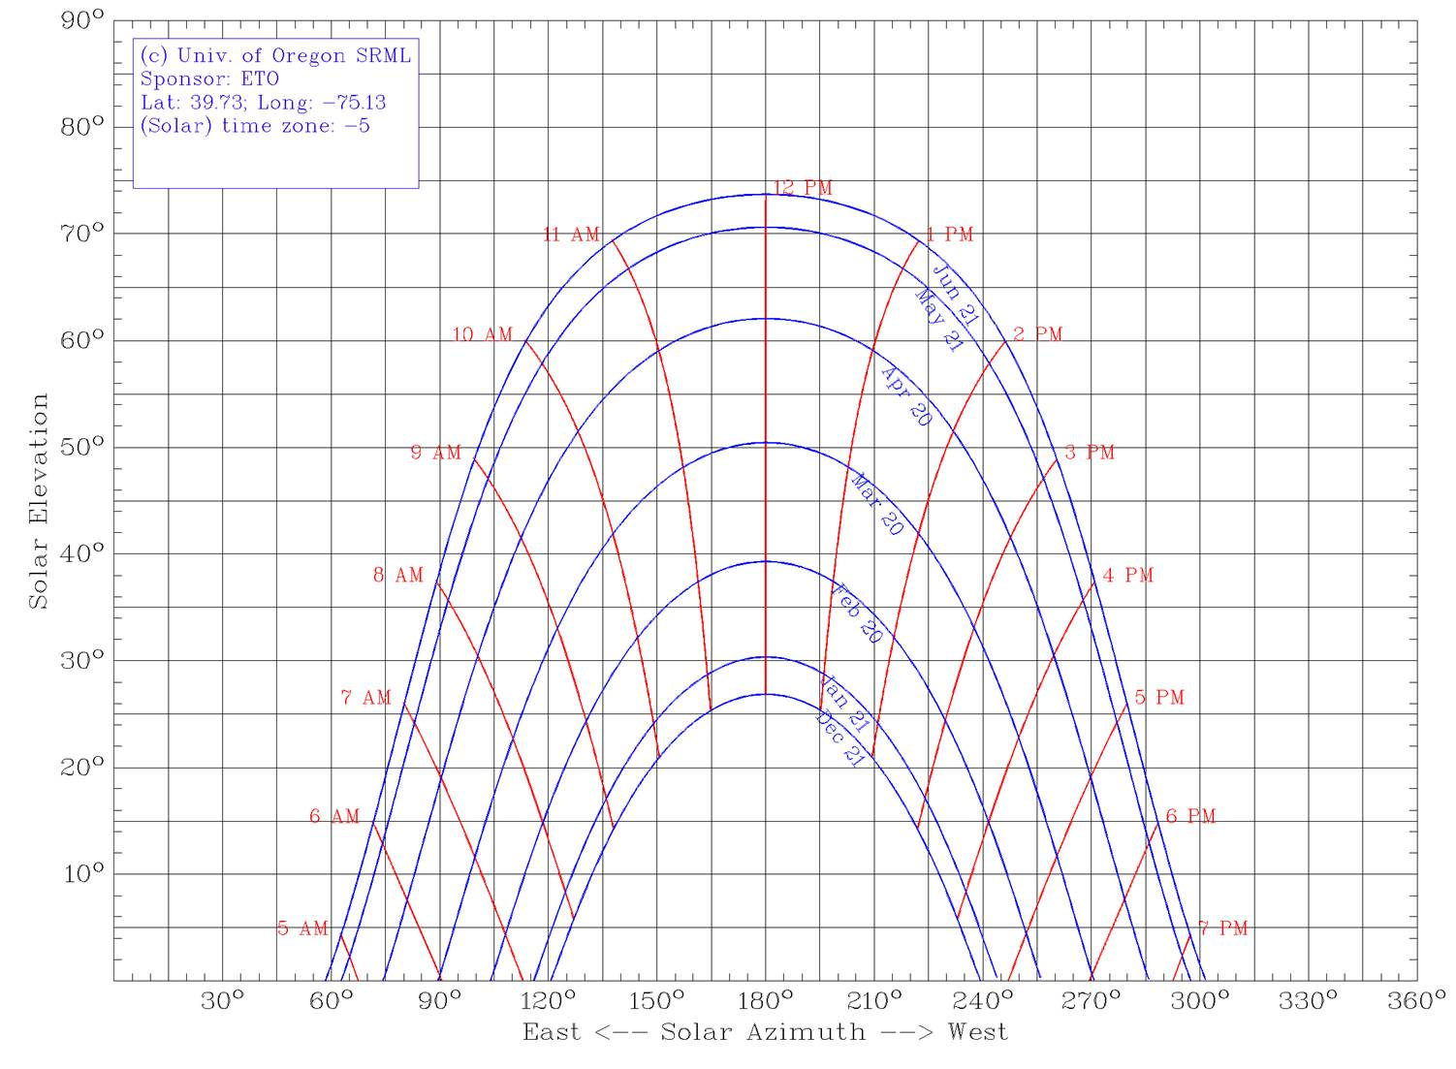
Sun Chart – Pitman NJ
α_{w} = 72°
→
←
α_{w} = 27°

Slide 31
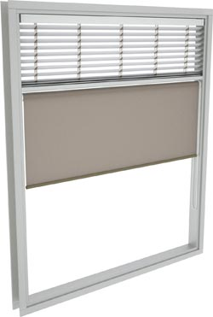
Shades
Iris Window Coverings (No endorsement intended)
Upper louvers adjusted to reflect ambient daylight toward ceiling
Roller shade used independently to control glare
www.iriswc.com

Slide 32
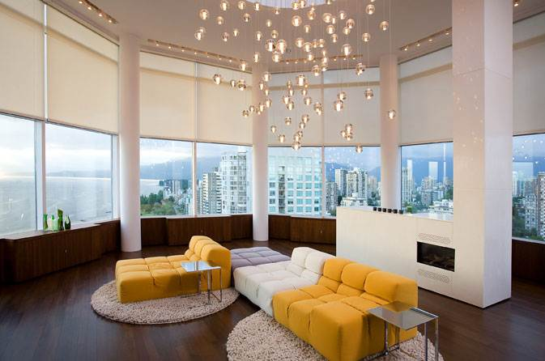
Sensors
blog.dsientertainment.com
Exterior Sensors used to control Shading
Interior Sensors to adjust electronic lights when clouds pass by
Automated Roler shades: NYT Test
http://windows.lbl.gov/comm_perf/nyt_roller-shades.html
Notes:
Windows harder to design (compared to skylights). High partitions will reduce effectiveness of windows. (http://www.facilitiesnet.com/lighting/article/Daylighting-Benefits-Lie-in-Proper-Design-Control--12119)

Slide 33
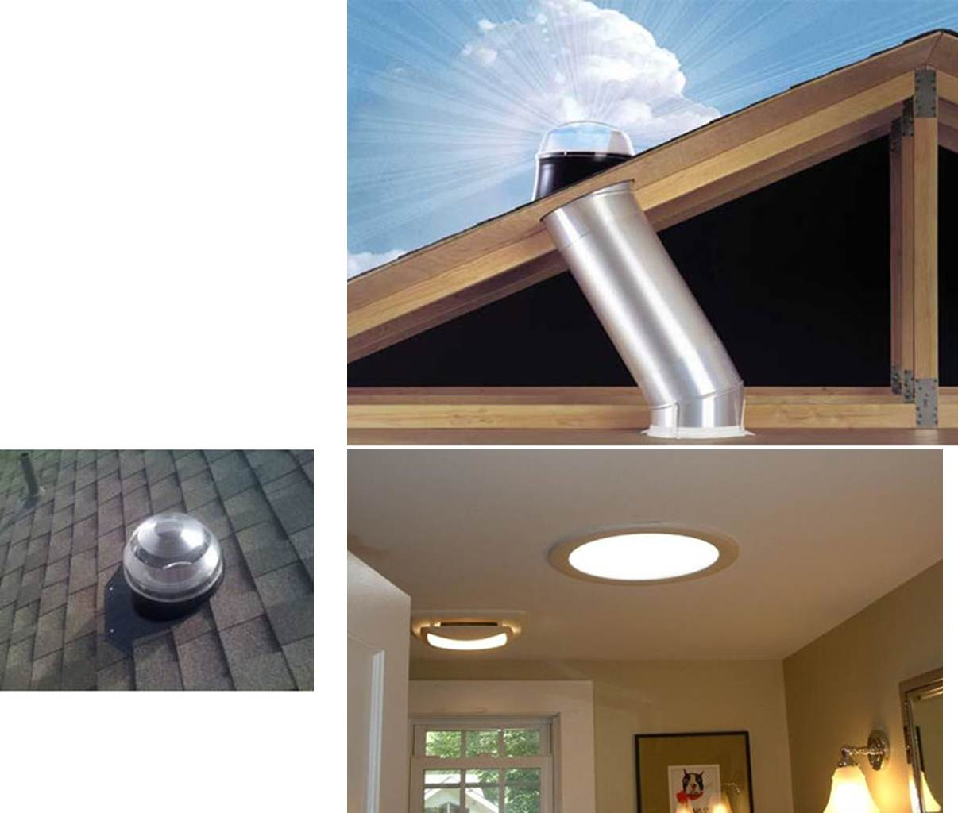
Light Tubes
cleangreenenergyzone.com
Collect
Transmit
Diffuse

Slide 34
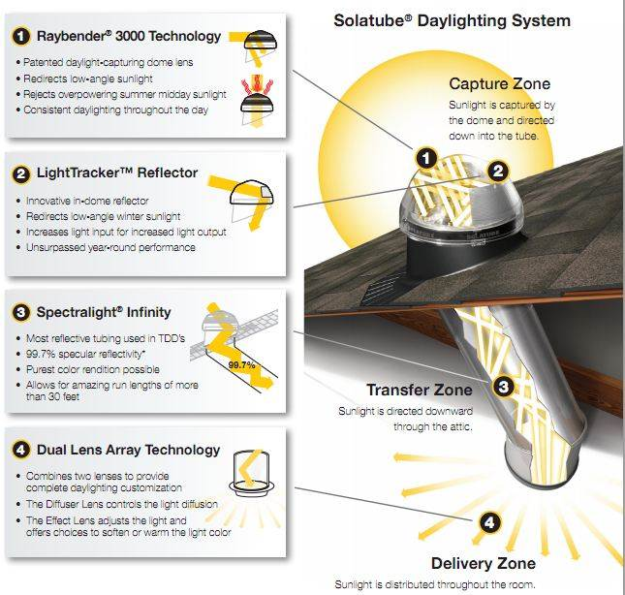
Light Tube
solatubelovesdaylight.files.wordpress.com

Slide 35
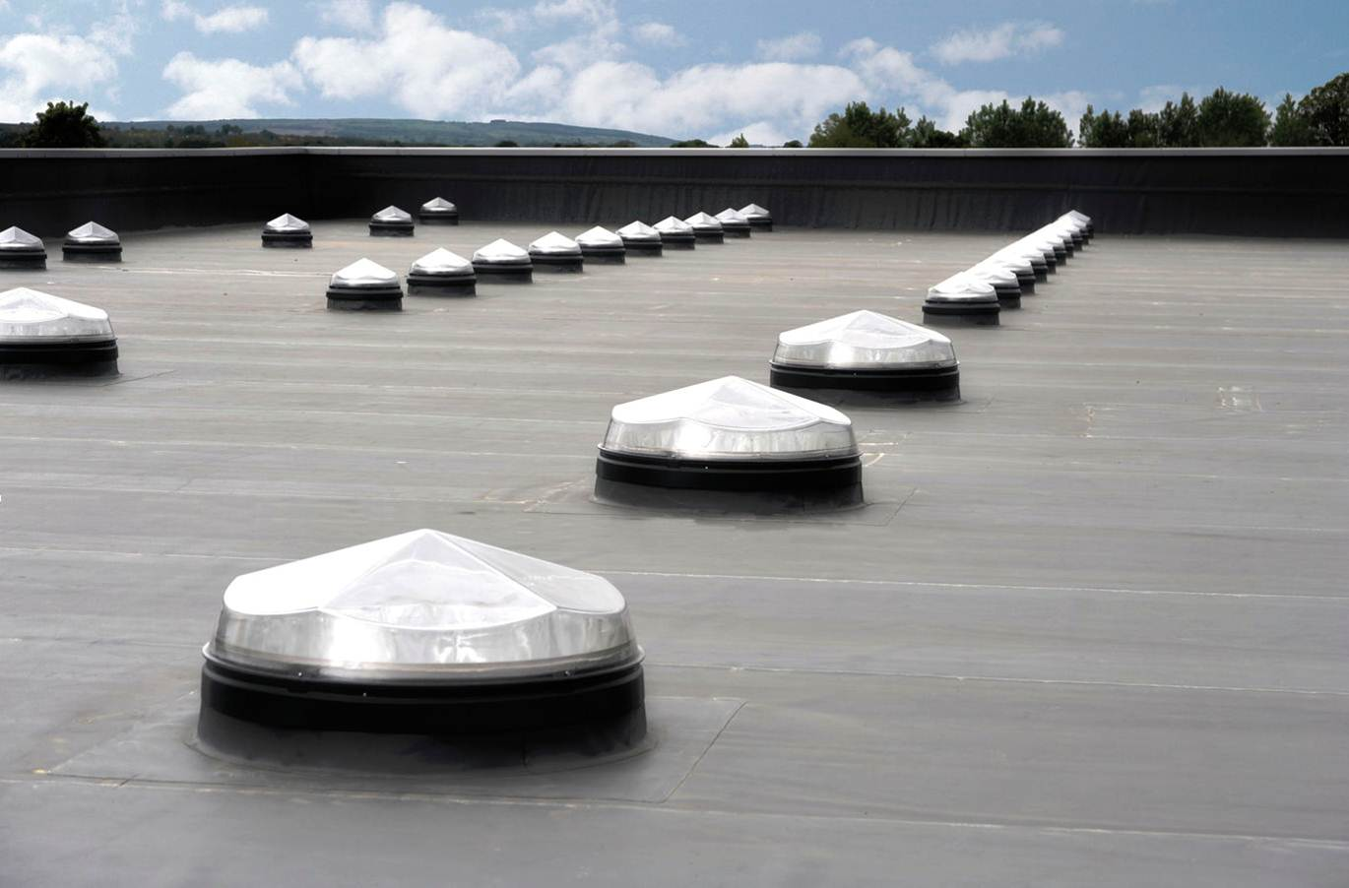
Light Tube
www.archiexpo.com
Notes:
The Monodraught SUNPIPE® natural daylight system directs sunlight into a room from roof level, particularly useful in areas where windows cannot reach. The energy free SUNPIPE collects daylight using a patented Diamond dome and has silverised mirror-finish aluminium tube that reflects the natural daylight down into the room or area below. The light is then evenly diffused by a translucent ceiling diffuser. The SUNPIPE is effective in sunny, overcast, and rainy conditions, and is compatible with many building designs. For example, multi-floor solutions are possible and common, but some loss of transmittance will occur due to the length of pipe required. The Diamond dome and diffuser also seals the SUNPIPE from the ingress of rain, dust, and insects. There is virtually no limit to the length of SUNPIPE or number of bends that can be used and the SUNPIPE can twist and turn easily to take natural light to exactly where you want it. When compared against a rooflight, a SUNPIPE eliminates glare, significantly reduces heat gains in the summer, and minimises heat losses in the winter. The SUNPIPE is manufactured in a wide range of diameters. The advantages of the system are:- * No structural alterations required, easily fits between joists and rafters. * No maintenance required and will not leak. * Top dome is self-cleaning due to its shape and eliminates condensation problems. * All SUNPIPE systems are guaranteed for 10 years against faulty manufacture. * Few fixings are required, normal single fixing at base of system. * Natural daylight helps combat Seasonal Affective Disorder (SAD) conditions.

Slide 36
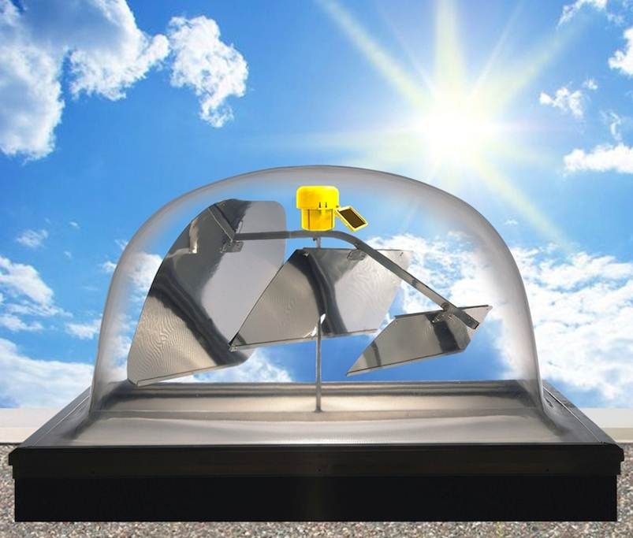
Active
www.ciralight.com
Notes:
Ciralight's SunTracker™ Skylights use a state-of-the-art Solar-Powered GPS Controller to track the sun all day. The sunlight is then reflected by a Mirror Array, transmitted down a highly reflective Lightwell, and into the building interior through a prismatic Diffusion Lens below the ceiling to effectively distribute daylight all throughout the space.

Slide 37
Indoor Lighting
Incandescent
Compact Fluorescent (CFL)
Linear (tube) Fluorescent
Light Emitting Diode (LED)

Slide 38
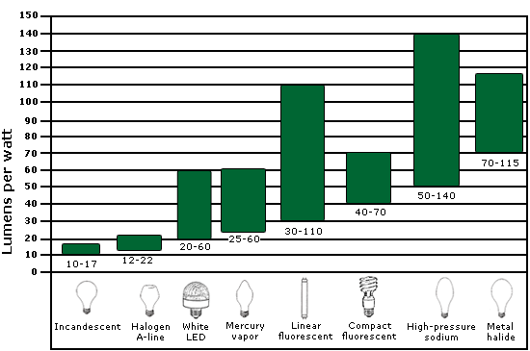
Lumens per Watt

Slide 39
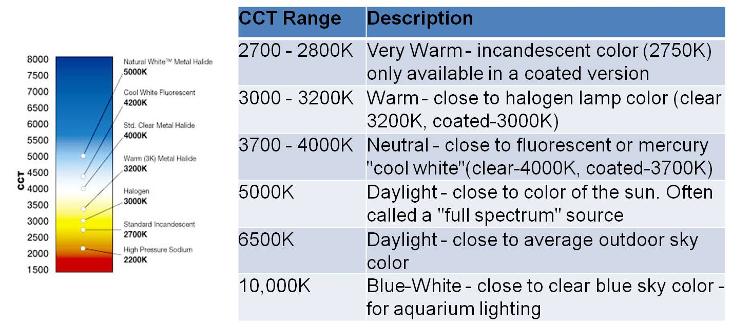
Color
Color
www.venturelighting.com

Slide 40
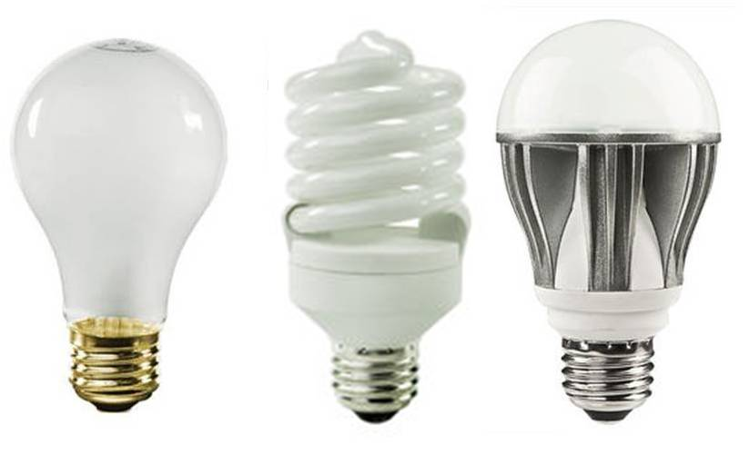
A19 Bulbs
75 Watt – Incandescent
75 W Equal
5,000 Life Hours
700 Lumens
Halco 6322
$0.5
20 Watt - CFL
75 W Equal
10,000 hr
1160 Lumens
5000K
1 mg Hg
NL-20450
$4.15
15 Watt - LED
75 Watt Equal
25,000 hr
1,100 Lumens
5000K
120° Beam Angle
Dimmable
Kobi Cool 75
$21.43
www.1000bulbs.com, 2013

Slide 41
Bulb Example
Is it worth investing in CFL or LED OVER Inc?
Assume 2500 h per year operation and $0.1/kWh
Inc lasts 2 y, CFL 4 y, LED 10 yr
Incremental Cost to Purchase
CFL =
LED =
Energy Savings
CFL =
LED =
Notes:
Is it worth investing in CFL or LED OVER Inc?
Assume 2500 h per year operation and $0.1/kWh
Inc lasts 2 y, CFL 4 y, LED 10 yr
Incremental Cost to Purchase
CFL = $4.15 - $0.5 = $3.65
LED = $21.43 - $0.5 = $20.93
Energy Savings
CFL = (75 W–20 W)·(kW/1000 W)·2500 h/y·$0.1/kWh = $13.75/y
LED = (75 W–17 W)·(kW/1000 W)·2500 h/y·$0.1/kWh = $15/y

Slide 42
Bulb Example Continued
Simple Payback Period
CFL =
LED =
Notes:
Simple Payback Period
CFL = $3.65 / $13.75/y = 0.3 y
LED = $20.93 / $15/y = 1.4 y
All paybacks less than expected bulb life

Slide 43
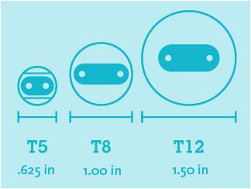
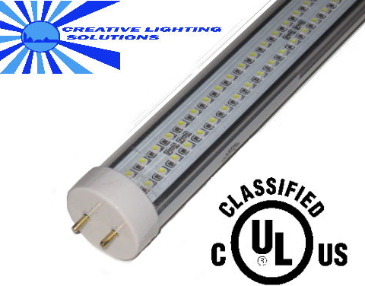
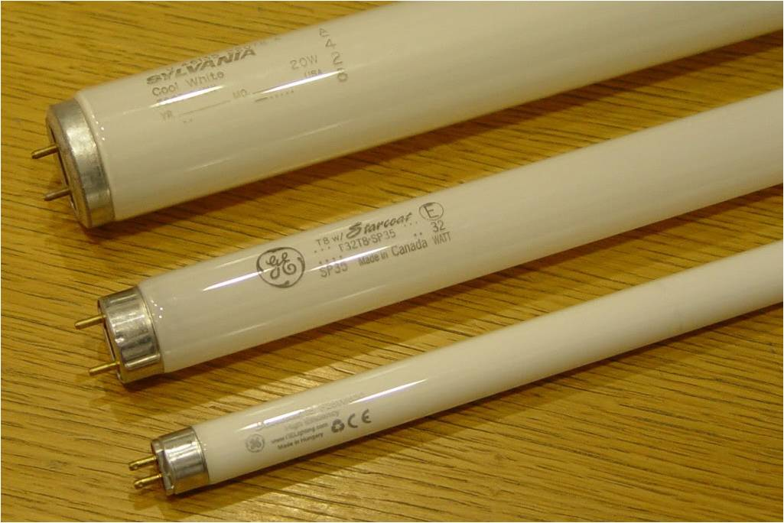
4’ Light Tube Types
www.hawaiienergy.com
www.creativelightings.com
greensavingsco.com

Slide 44
4’ Light Tubes
T12 34 W $4
4100K 28,800 hr 1656 Lumens (only in case of 30) [Sylvania 24588]
T8 25 W $4.1
4100K 20,000 hr 1755 Lumen (only in case of 30) [Sylvania 21942]
T8 24 W $5.78
4100K 20,000 hr 1860 Lumens (only in case of 40) [Sylvania 20931]
LED T8 17 W $54.95
4500K 100,000 hr, 1500 Lumens [Creative Lighting Solutions]
www.1000bulbs.com, 2013
www.creativelightings.com
Notes:
T8 21 W 3000K 20,000 hr, 1953 Lumens, $6.45 (only in case of 40), 20919www.ledlight.com
Ballast takes 30-40 W more (4 tube fixture)?

Slide 45
Tube Example
Is it worth investing in T8, T5, or LED OVER T12?
Assume 2000 h per year operation and $ 0.1 / kWh
T12, T8, T5 last 10 y, LED lasts 50 y
Incremental Cost to Purchase
T8 =
T5 =
LED =
Energy Savings
T8 =
T5 =
LED =
Notes:
Incremental Cost to Purchase
T8 = $4.1 - $4 = $0.1
T5 = $5.78 - $4 = $1.78
LED = $54.95 - $4 = $50.95
Energy Savings
T8 = (34 W – 25 W)·(kW/1000 W)·2000 h·$0.1/kWh = $1.8/y
T5 = (34 W – 24 W)·(kW/1000 W)·2000 h·$0.1/kWh = $2/y
LED = (34 W – 17 W)·(kW/1000 W)·2000 h·$0.1/kWh = $3.4/y

Slide 46
Tube Example Continued
Simple Payback Period
T8 =
T5 =
LED =
Notes:
Simple Payback Period
T8 = $0.1 / $1.8/y = 0.1 y
T5 = $1.78 / $2/y = 0.9 y
LED = $50.95 / $3.4/y = 15 y
All paybacks less than expected tube life

Slide 47
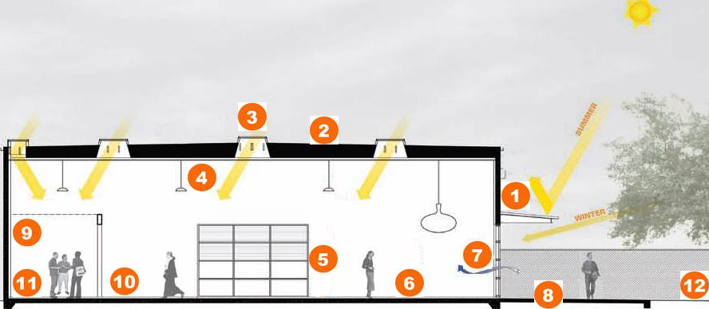
Case Study: Integrated Design Associates
ideasnetzero.wordpress.com
Sunshade with building-integrated photovoltaics
Roof with building-integrated photovoltaics
Skylights with spectrally-sensitive glass
Energy-efficient and occupancy-sensor controlled light fixtures
Electrochromic window
Floor-installed radiant heating/cooling
Natural ventilation
Ground-source heat pump
Building management system for circuit-by-circuit monitoring
Energy-efficient office equipment
Energy-efficient IT and telecom strategy
Water-efficient landscaping
Notes:
Electrochromic -> Smart glass, Magic Glass, or switchable glass, also called smart windows or switchable windows in its application to windows or skylights, refers to electrically switchable glass or glazing which changes light transmission properties when voltage is applied.
Certain types of smart glass allow users to control the amount of light (and thereby heat) transmission. When activated, the glass changes from transparent to translucent, partially blocking light while maintaining a clear view through the glass. Another type of smart glass can provide complete privacy when activated.
Smart glass technologies include electrochromic devices, suspended particle devices, micro-blinds and liquid crystal devices.
The use of smart glass can save costs for heating, air-conditioning and lighting and avoid the cost of installing and maintaining motorized light screens or blinds or curtains. When opaque, liquid crystal or electrochromic smart glass blocks most UV, thereby reducing fabric fading; for SPD-type smart glass, this is achieved when used in conjunction with low emissivity coatings.
Critical aspects of smart glass include installation costs, the use of electricity, durability, as well as functional features such as the speed of control, possibilities for dimming, and the degree of transparency of the glass.
Wikipedia

Slide 48
Case Study: Stanton W. Mead Education & Visitor Center - Milladore, WI
Daylighting & Advanced Lighting Controls
Ceiling heights tied to height & location of transom windows
Exterior overhangs reduce glare & overheating (reduce cooling loads)
Interior transom windows to borrow light from adjacent spaces;
Interior ceiling finishes and configurations to bounce into interior
Interior wall finishes reflecte light penetration and reduce contrast
Suspended direct/indirect pendant lighting → ambient lighting
Supplemental task lighting at workstations and task areas
Daylight sensor-operated controls for lighting fixtures
cut-off and dimming
Occupancy sensor-operated controls for specific spaces
Low-wattage fluorescent and compact-fluorescent lighting fixtures
L.E.D. low-wattage exit signs and other fixtures
www.tombrownarchitect.com

Slide 49
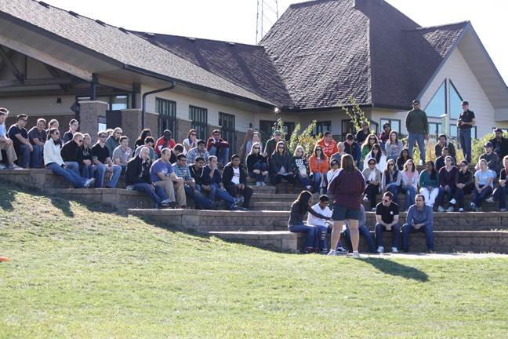
Stanton W. Mead Center - Milladore, WI
www.meadwildlife.org

Slide 50
Outdoor Lighting
Lighting Type | Efficiency (lumens/watt) | Lifetime (hours) | Color Rendering Index (CRI) | Color Temperature (K)
Mercury vapor | 25-60 | 16000 - 24000 | 50 (poor to fair) | 3200-7000 (warm to cold)
Metal Halide | 70-115 | 5000 - 20000 | 70 (fair) | 3700 (cold)
High-Pressure Sodium | 50-140 | 16000 - 2400 | 25 (poor) | 2100
Low-pressure sodium | 60-150 | 12000 - 18000 | 0 -18 (very poor) | NA
LED | 67 | >50,000 | 75 | 6000
Miller (2012) "Outdoor Area Lighting", apps1.eere.energy.gov, accessed on November 20, 2012

Slide 51
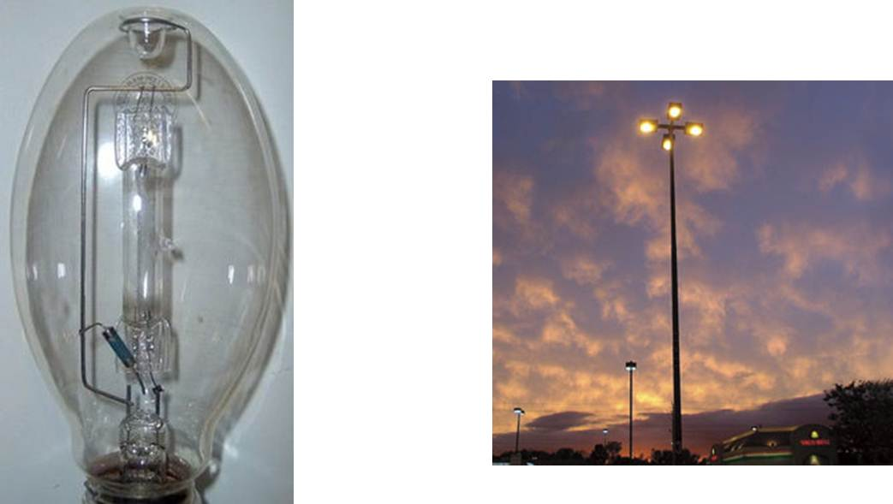
Mercury Vapor
upload.wikimedia.org
www.westinghouselighting.com
outdoor security, area lighting, general flood lighting, barns, parking lots

Slide 52
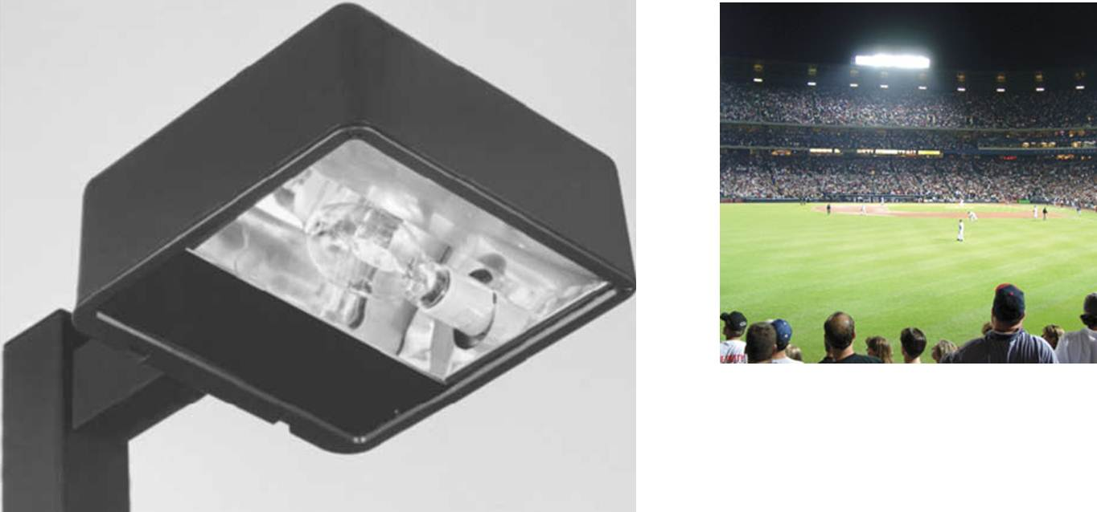
Metal Halide
www.westinghouselighting.com
retail, industrial, area lighting, accent lighting, sports lighting, security lighting, roadway lighting, parking garage

Slide 53
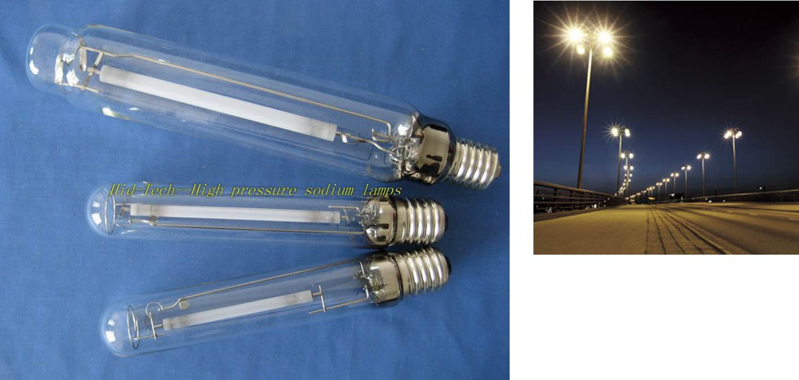
High Pressure Sodium
image.made-in-china.com
www.westinghouselighting.com
outdoor security, parking garage, parking lot, roadway lighting, area lighting applications

Slide 54
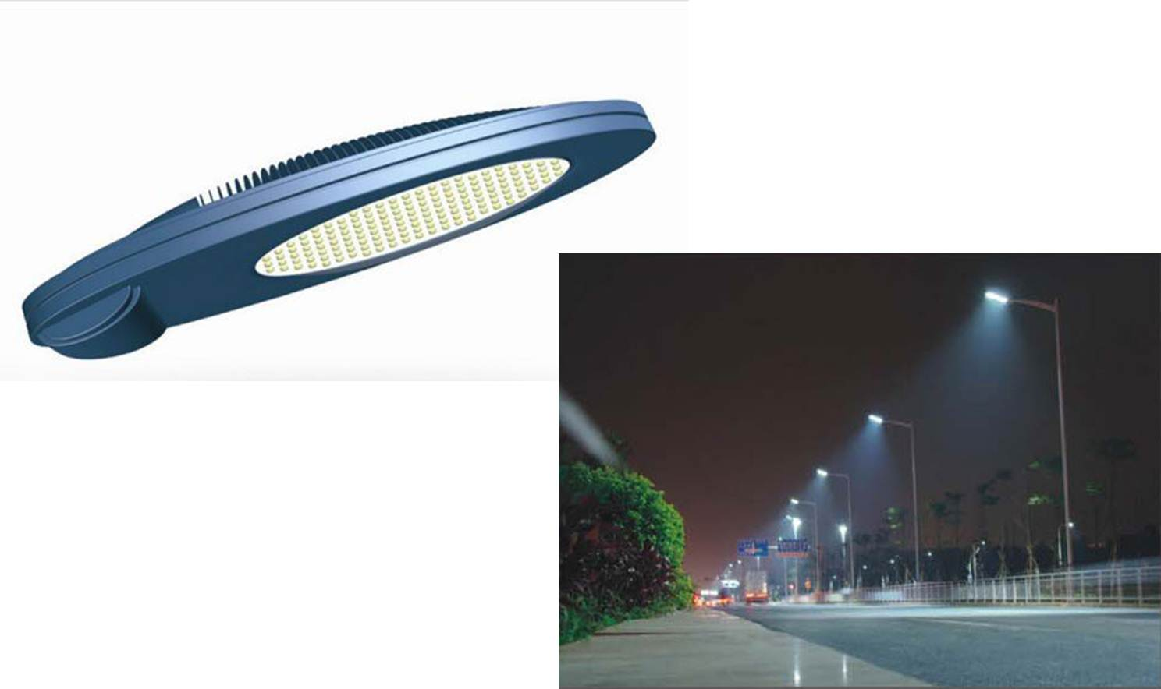
LED
i00.i.aliimg.com
www.bulklights.com
Cobra Head Led Street Light

Slide 55
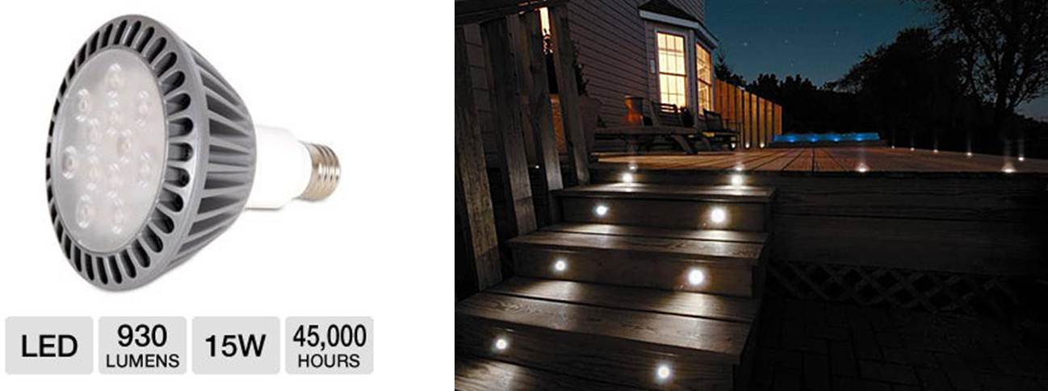
LED accent lighting
images.highspeedbackbone.net
blog.pegasuslighting.com

Slide 56
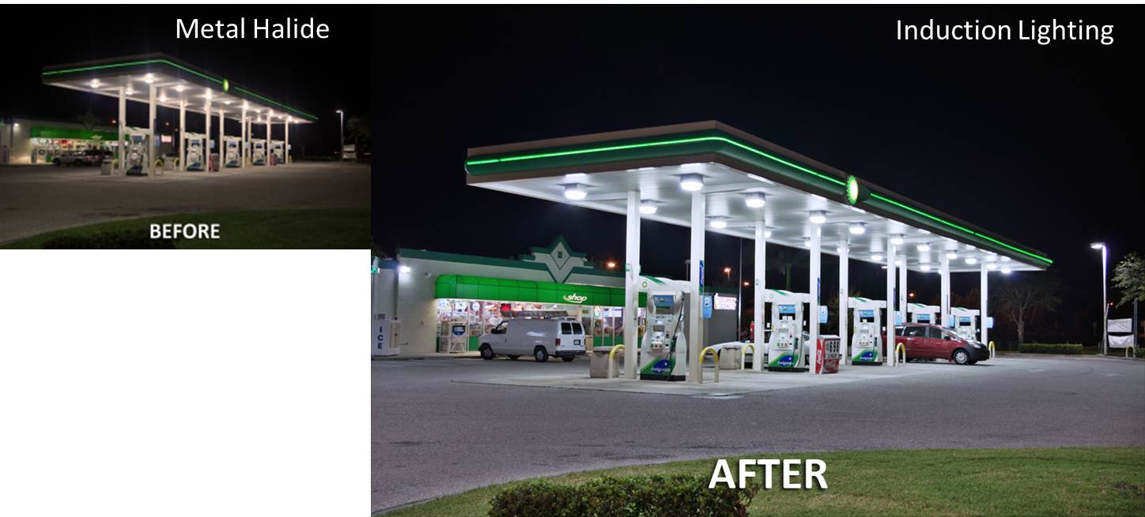
Case Study: Gas Station
synergylightingusa.com
20 years maintenance free operation
cost savings over life of fixtures > $300,000
Better Color, No Color Change
Less change in Illumination levels over time
Notes:
synergylightingusa.com/blog/retrofits/-> Typically a Gas Station or Convenience Store has outdoor lighting that consists of 3 different types of lighting. These are Canopy Lighting over pumps and portico’s, Wall Packs mounted to the building structure and Parking Lot Lighting. These fixture types are usually Metal Halide - High Intensity Discharge Systems which provide high levels of illumination along with extreme amounts of glare. With the ever growing size of the stores offering more and more products and services to clientele, the lighting systems can become quite extensive with massive amounts of fixtures to draw in customers. However the operating and maintenance costs of the metal halide system is extremely high. The metal halide lighting systems suffer from a wide variety of problems from color shift (lamps turning pink and green) and if not replaced regularly well before the useful life is reached of the lamps, the metal halide lamps will lose an average of 35% of its original light output.
The Advantage Of Induction Lighting
An alternative to the Metal Halide lighting systems is LED Lighting, and Induction Lighting. Each offer distinct advantages, however the Induction Lighting System offers a greater cost effectiveness while drawing in larger volumes of traffic flow to a gas station. Unlike metal halide which suffers from rapid lumen depreciation and color shift, the induction lighting system maintains 95% of its lumen output and never changes colors. The induction system uses a cathode-less high lumen fluorescent lamp which operates at much cooler temperatures and requires up to 68% less energy than metal halide. A standard 320W Pulse Start or 400W Metal Halide canopy fixture can be retrofitted with a 200 Watt induction fixture and provide higher light levels with tremendous savings. Because the induction system does not use cathode lamps, the systems offers 20 years of maintenance free operation with no bulb or ballast replacements as there is no cathode to burn out and the generator is completely electronic. This is a phenomenal feature that rivals LED Lighting systems with twice the life and less than half the cost. The induction lighting system offered by Synergy Lighting come standard with 5000K Pure Natural Daylight Lamps which most closely resemble natural sun light. This creates a very bright, clean and glare free presentation to customers and is attributed to increased customer traffic and sales.
The BP Gas Station and Convenience Store pictured in this article utilized Synergy Lighting’s 5000K Induction Lighting Fixtures. The end result for BP is a higher level of attraction to clientele, 20 years of maintenance free operation and a cost savings over the life of the fixtures in excess of $300,000. BP Corporate and franchise stores often operate at 5% net profit. This means that the energy and cost savings to BP is equal to an increased revenue of $6,000,000.00 not to mention the increased revenue resulting from the increased customer traffic.
Where there is light, there is Synergy Lighting. For more information on switching to Energy Saving, Induction Lighting, view our website and call Synergy Lighting for a free consultation.

Slide 57
Light Pollution
Problems
Glare
Trespass
Sky Glow
Solutions
Do not over light
Direct light
LED
Shade
Timers, Sensors

